Slide 1
Cryptocurrency Analysis
2018
Alex garfias
Aritra ghosh
Brandon leal
Andrew Scott

Slide 2
Team Motivation for Crypto
Much of our motivation surrounding choosing crypto currency is because it’s a hot topic right now
We wanted to know based on historical data if crypto currencies were a good option for long term investments?
Using historical data are crypto currencies a good choice to use to trade with?
Do currency changes correlate with each other?
We leveraged Bitcoin, LiteCoin, and Ethereum
Based off of 2018 historical data, crypto currencies do not make a good long term investment, however choosing to trade currencies can make for a profitable portfolio as you will see in the next few slides.

Slide 3
Results High-level
Based off of 2018 historical data, crypto currencies do not make a good long term investment
However choosing to trade currencies can make for a profitable portfolio as you will see in the next few slides
Daily variances vary greatly

Slide 4
HISTORY & EVOLUTION
1998 – 2009 The pre-Bitcoin years
Although Bitcoin was the first established cryptocurrency, there had been previous attempts at creating online currencies, two examples of these were B-Money and Bit Gold, which were formulated but never fully developed.
In 2009, a paper called Bitcoin – A Peer to Peer Electronic Cash System was posted to a mailing list discussion on cryptography, by Satoshi Nakamoto, whose real identity remains a mystery.
In 2010, Bitcoin is finally valued, then in 2011 rivals appear (Namecoin & Litecoin) which led to Bitcoin crash in 2013.
Ehereum appears in 2016

Slide 5
Data Cleaning and Exploration
Initial data gathering proved to be more difficult than we anticipated, many sites wanted us to subscribe to gather historical data
Google has depreciated their finance API
Yahoo API is no longer updated, and has minimal documentation
Ultimately data was extracted from Yahoo, and QuantConnect
Data scrubbing was completed- gathering our data into dataframes, changing decimals to whole numbers, creating moving averages
Connecting to Twitter data proved to be a challenge
To evaluate data for trading Monte Carlo simulations were completed

Slide 6
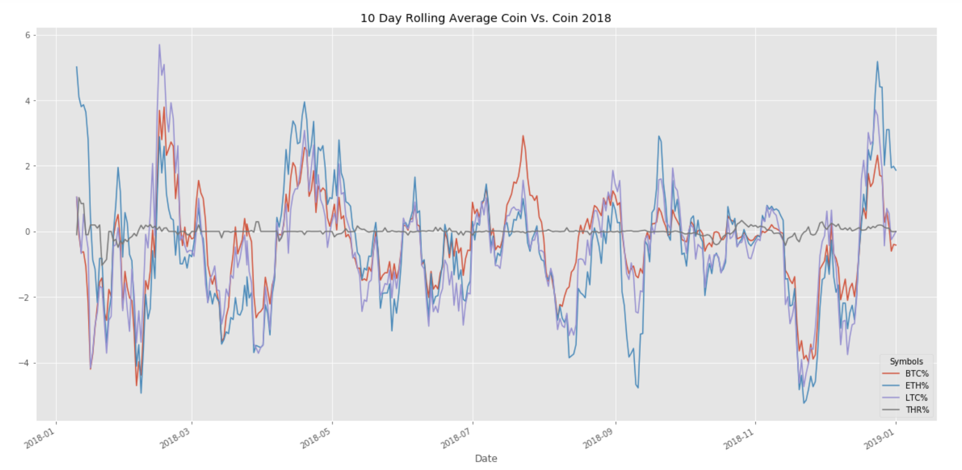
Coin vs. Coin Comparisons
What do the daily changes look like compared to the Dollar?
Mean % Change 2018
BTC% -3.395422e-01
ETH% -4.556945e-01
LTC% -5.310612e-01
Coin with the greatest variance?
LiteCoin- Nearly 30% up
And 25% down in a single day!
Is there a correlation between daily changes?
Coin vs. Coin P-Value = 0.2500
P-Value W/ Tether = 1.7157990391769624e-07

Slide 7
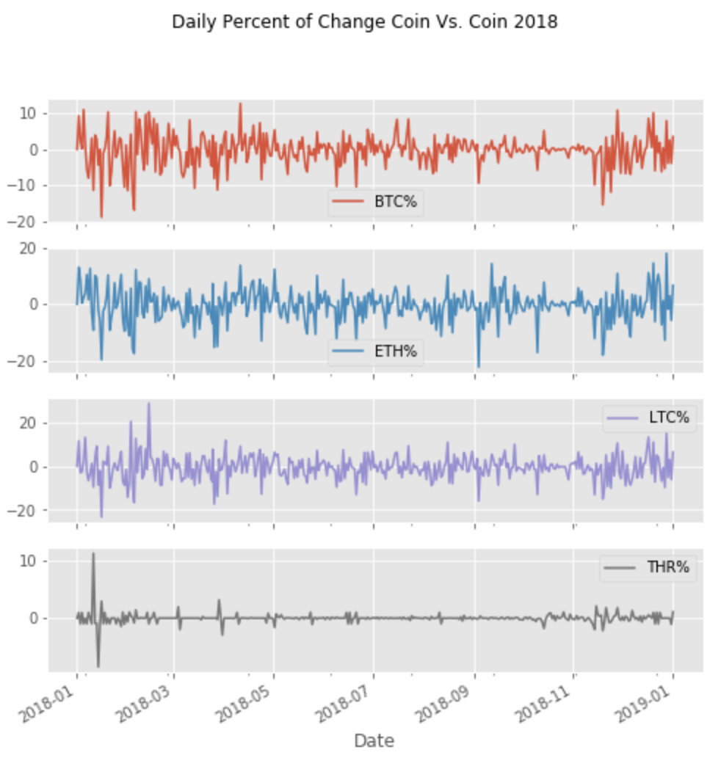
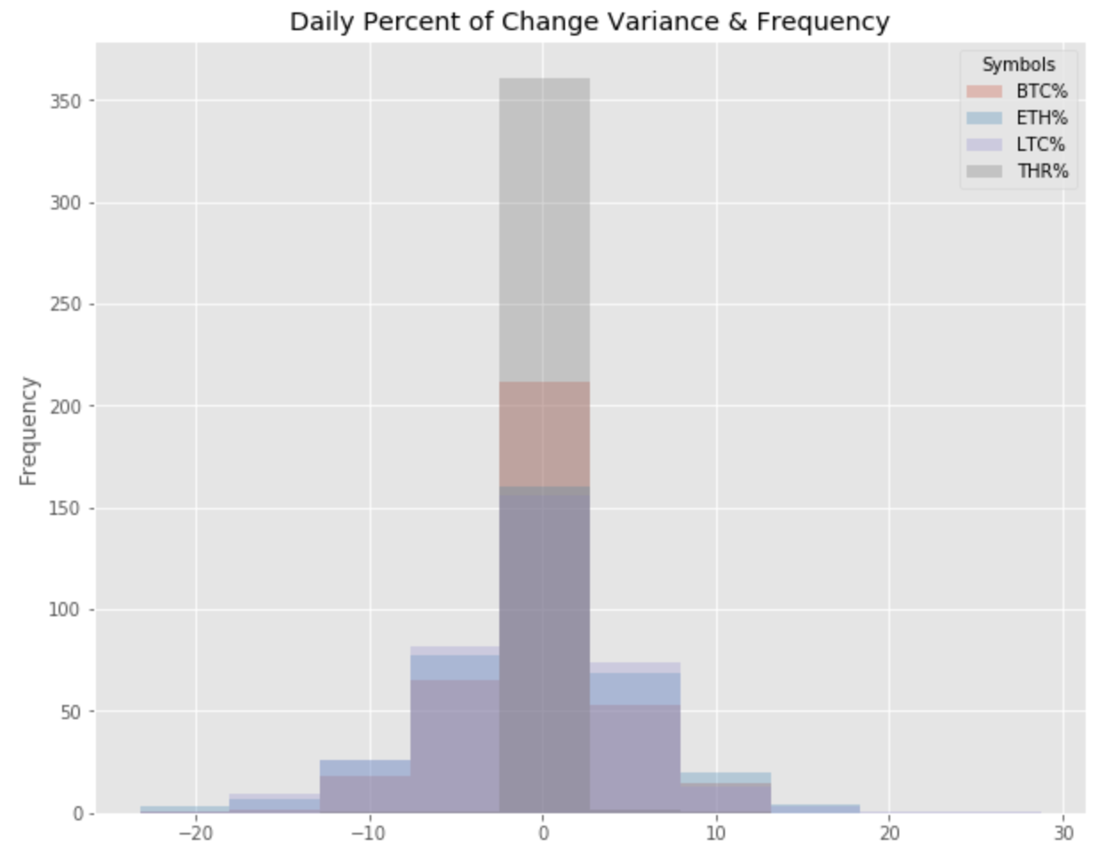
Coin vs. Coin Comparisons
Which coin has the most variance?
Wild daily variances observed from +30% to -25%
Note Tether (USD) stays very consistent with minimal change

Slide 8
SHARP RATIO S&P VS CRYPTOS
First bullet point here
Second bullet point here
Third bullet point here
Class | Group 1 | Group 2
Class 1 | 82 | 95
Class 2 | 76 | 88
Class 3 | 84 | 90

Slide 9
HEDGING
Step 1 Title
Task description
Task description
Step 2 Title
Task description
Step 3 Title
Task description
Task description
Task description

Slide 10
Post Mortum & Difficulties
Our biggest challenge proved to be connecting to data
Several hours were spent running simulations to identify trending
Discuss any additional questions that came up, but which you didn't have time to answer: What would you research next, if you had two more weeks?

Slide 11
Questions?

Slide 12
Add a Slide Title - 2

Slide 13
Add a Slide Title - 3

Slide 15
Add a Slide Title - 4

Slide 16
Add a Slide Title - 5

